Slide 1




Miller Comprehensive High School
Course Selection 2025-2026
Welcome!!!!
Meet the Student Services Team:
Jodi Baragar
Mindy Harbus
Navanga Burke
Laura Gaboury
Respectfully acknowledging that we are blessed to live on Treaty 4 Territory, traditional lands of the Nêhiyawak, Nahkawé, Nakota, and homeland of the Métis, Lakota, and Dakota.

Slide 2


Miller Comprehensive High School
Course Selection 2025-2026
What Classes Should I Take?
This Photo by Unknown Author is licensed under CC BY-NC

Slide 3
Students Must Have 24 Credits
A credit is earned when a class is successfully completed. Students must have a minimum of 24 credits to graduate which includes compulsory subjects at each grade level.
Students in French Immersion also need a minimum of 24 credits. To graduate with a French Immersion designation, students must have at least 12 of their credits from the French Immersion Program.

Slide 4
French Immersion Students Must Have 24 Credits
For Bilingual Mention, students must take a minimum 12 credits from French Immersion Subjects in grades 10-12.
The following French Immersion courses are offered at Miller High School:
Études catholiques 10, 20, 30 Mathématiques 20 Fondements
Français 10, 20, 30 Mathématiques 20 Pré-calcul
Sciences 10 Mathématiques 30 Fondements
Sciences sociale (Histoire) 10 Mathématiques 30 Pré-calcul
Sciences sociale (Histoire) 20 Sciences sociales 30
Mathématiques 10 Fondements/Pré-calcul Litteratie financiere 10
Three compulsory English Language Arts credits are required for Graduation.
ELA 10
ELA 20
ELA 30

Slide 5
Grade 10 Course Requirements
Math 10 FP or WA / Math 11
Catholic Studies 10
ELA 10
Science 10 / 11
History 10 / 11 or Native Studies 10
Financial Literacy 10
4 Electives

Slide 6
French Immersion Grade 10 Course Requirements
      Mathématiques 10- Fondements/Pré-calc
      Études catholiques 10
      Français 10
      ELA 10
      Litteratie financiere 10
      Science naturelles 10
      Histoire 10
      3 Electives

Slide 7
Grade 11 Course Requirements
  **NOTE: a Social Science 20 is no longer required for graduation, but it may assist with early conditional acceptance for post-secondary.
      Catholic Studies 20
      ELA 20 / 21
      Math 20 / 21 (Workplace/Foundations/Pre-Calculus)
      Science 20 / 21 (Computer/Environmental/Health/Physical)
      Electives (6)

Slide 8
French Immersion Grade 11 Course Requirements
  **NOTE: a Social Science (Histoire 20) is no longer a graduation requirement but may assist with a FI designation and early conditional acceptance for post-secondary.
      Mathématiques 20 (Fondements/Pré-calc)
      Études Catholiques 20
      Français 20
      ELA 20
      Science 20
      4 Electives

Slide 9
Grade 12 Course Requirements
Catholic Studies 30
ELA 30
Social Studies 30 / 31 or Native Studies 30
Electives
5 Credits need to be at the 30 level

Slide 10
French Immersion Grade 12 Course Requirements
      Études Catholiques 30
      Français 30
      ELA 30
      Sciences Sociales 30
      5 Electives

Slide 11

So, Which Math Class Should I Take?
The answer depends:
    Post-secondary plans
    Math strengths
    Recommendation of your math teacher

Slide 12
Math Department Recommendations
If your mark in Math 9 is under 60% or you are unsure about your career path, you should consider taking both Workplace & Apprenticeship 10 and Foundations & Pre-Calculus 10.
If you plan to take Calculus later, you should take Foundations & Pre-Calculus 10 in the first semester and Foundations 20 in the second semester.
It is not recommended to take Pre-Calculus 20 in grade 10 and it is recommended to complete Foundations 20 before taking Pre-Calculus 20.

Slide 13
Math Pathways
Workplace and Apprenticeship
Content in this pathway was chosen to meet the needs of students intending to pursue careers based on post-secondary education at Sask Polytech, or non-math oriented faculties at universities
2. Foundations
Content in this pathway was chosen to meet the needs of students intending to pursue careers in areas that typically require university, but are not math intensive, such as the humanities, fine arts, social sciences, business and nursing.
3. Pre- Calculus
Content in this pathway was chosen to meet the needs of students interested in pursuing careers in science-related or math related areas.

Slide 14
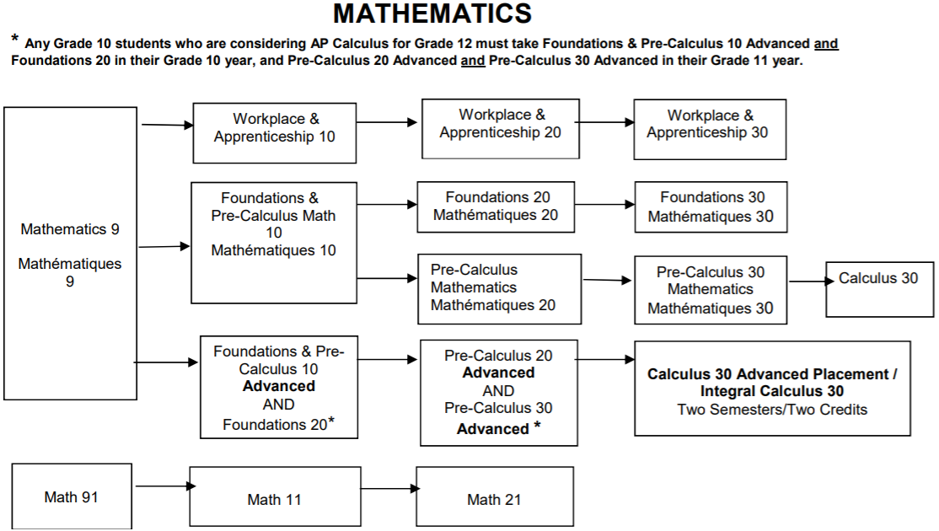


Slide 15
Career Options and Trades with Workplace & Apprenticeship Math
Justice Studies diploma
Correctional Studies
Photography
Continuing Care
Early Childhood Education
Graphic Communications
Funeral Services
Heavy Equipment Operator
Plumbing and Pipefitting
Machining
Welding
Carpentry
Bricklayer
Esthetician
Hairstylist
Hotel and Restaurant Management

Slide 16
University of Regina Faculties that accept Workplace and Apprenticeship Math:
Faculty of Arts
Education (most programs)
Media, Arts & Performance (formerly Fine Arts)

Slide 17
University of Regina Faculties that accept Foundations Math:
Faculty of Arts
Education (most programs)
Media, Arts & Performance (formerly Fine Arts)
Business Administration
Nursing

Slide 18
University of Regina and Saskatchewan Polytechnic programs that require the Pre-Calculus Math Pathway:
Faculty of Arts
Education (Teaching math/science at the high school level)
Media, Arts & Performance (formerly Fine Arts)
Business Administration
Nursing
Engineering and Engineering Technologies
Science
Pre-professional programs (e.g., pharmacy, medicine, veterinarian medicine, dentistry, optometry, physical therapy)
Kinesiology

Slide 19
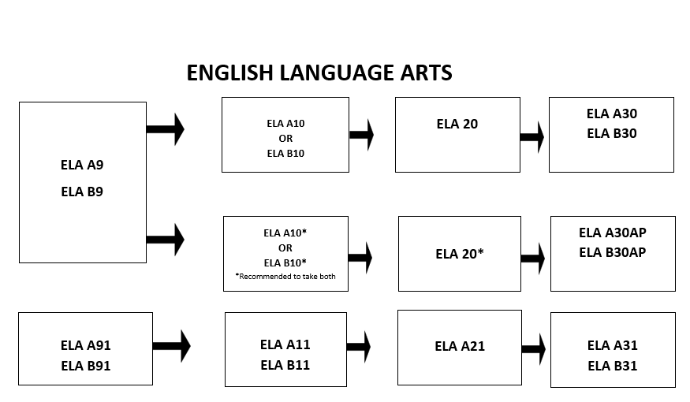
ELA 10
ELA 30
ELA 10
Advanced
ELA 20
Advanced & Literature Composition 20
ELA 30
Advanced & Literature Composition 30
AP Pathway
ELA 11
ELA 21
ELA 31

Slide 20
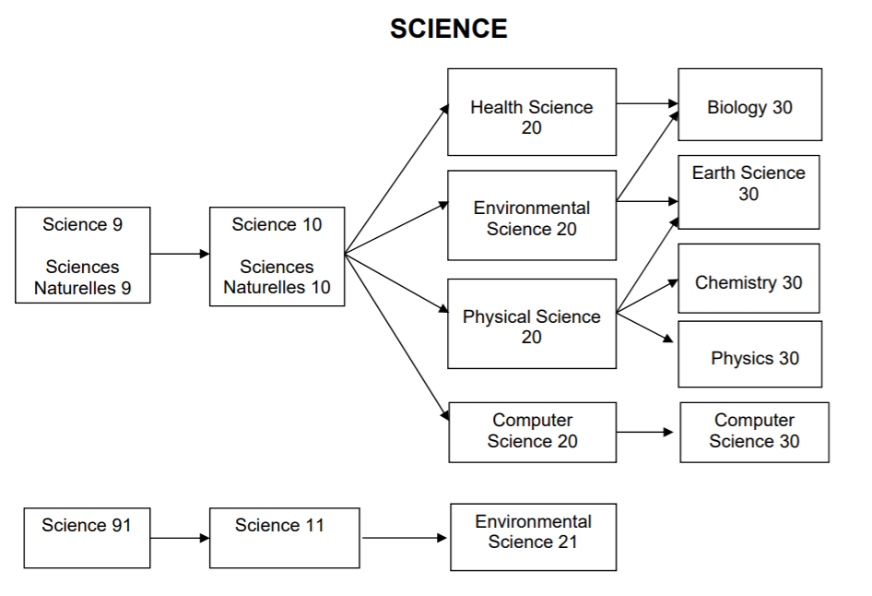
Please note the Physical Science 20 is recommended in Grade 11 due to the math content in the course.

Slide 21
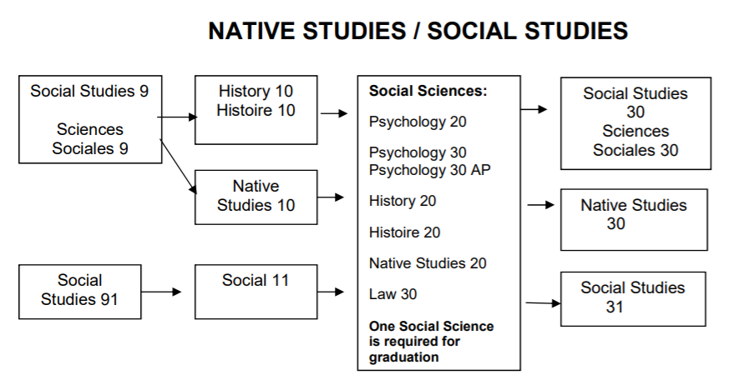
Social Science 20/30 Level Courses
History 20
Law 30
Native Studies 20
Psychology 20
Psychology 30
**NOTE: a Social Science (Histoire 20) is no longer a graduation requirement but may assist with a FI designation and early conditional acceptance for post-secondary.

Slide 22
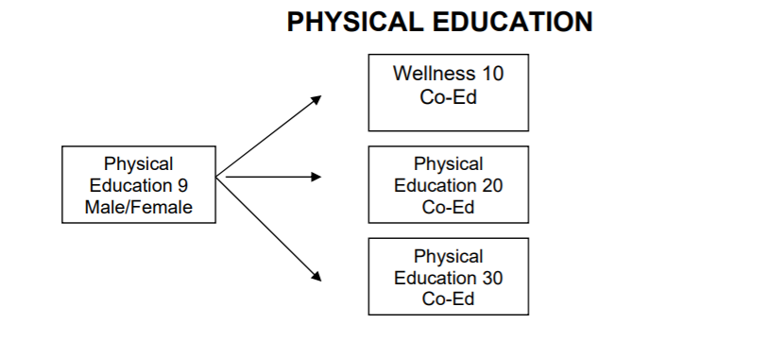
One Phys. Ed. at the 10, 20 or 30 level is compulsory in order to graduate. Please note that Wellness 10 does not have a fee associated with the class, but Phys. Ed. 20 and 30 have fees.

Slide 23

ADVANCED PLACEMENT (AP)
Students can challenge themselves academically
Provide challenges for higher level thinking and more in-depth application of knowledge and skills
Scoring a 4 or 5 on an AP exam will help students gain a university credit (save time and money)

Slide 24
AP Mathematics Track
 | Semester One | Semester Two
Grade 10 | Math Foundations 10 Advanced | Math Foundations 20
Grade 11 | Pre-Calculus 20 Advanced | Pre-Calculus 30 Advanced
Grade 12 | AP Calculus/ Integral Calculus | AP Calculus (Exam in May)

Slide 25
Other AP course offerings
 | Semester One | Semester Two
Grade 11 Or Grade 12 | Psychology 20 Computer Science 30 Francais 30 | Psych 30 AP AP CS Prep Course French Language and Culture Prep Course (Exams in May)

Slide 26
AP English Track
 | Semester One | Semester Two
Grade 10 | Advanced ELA 10 | Your ELA 10 can be taken in semester 1 or 2
Grade 11 | Advanced ELA 20 | Literature and Composition 20
Grade 12 | Literature and Composition 30 | AP ELA 30 (Exam in May)

Slide 27

Interested in online learning?
Do you have good written communication skills?
Are you self-motivated and self-disciplined?
Are you willing to contribute & actively participate?
Do you have a good knowledge of computer skills?
Are you committed?

Slide 28

Learning Online
Maximum of 2 courses and must have a form signed
Student Services will assist you with registering for an online class.
School administration has to give final permission before enrolled
Grade 10 students will be placed in a tutorial if they choose an online course

Slide 29


Electives
For more Information please our Course Description on the website. Please click the link below:
Advanced Baking
Accounting
Band and/or Choral/Vocal Jazz (EB)
Mechanics & Automotive
Commercial Cooking
Communication Media
Construction & Carpentry
Creative Writing
nêhiyawêwin 10 (Cree)
Hairstyling and Esthetics
Drama
Media Studies
Financial Literacy
Music
Physical Education/Wellness
Psychology
Sports Medicine
Visual Arts
Entrepreneurship
Photography
Law
Native Studies 20
History 20
Welding

Slide 30
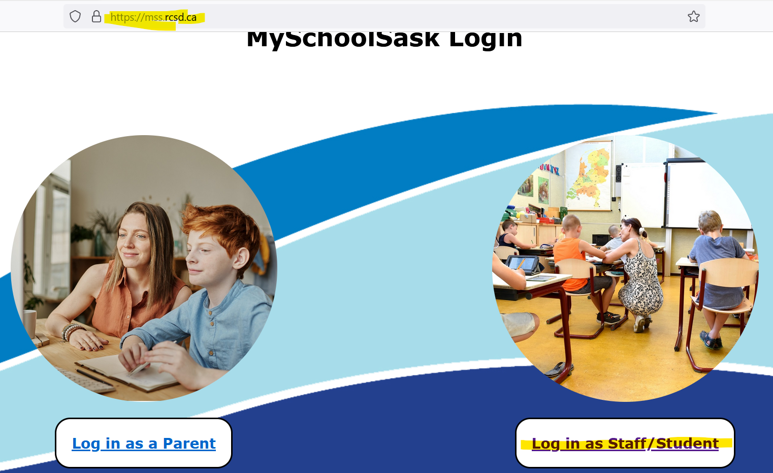

Slide 31
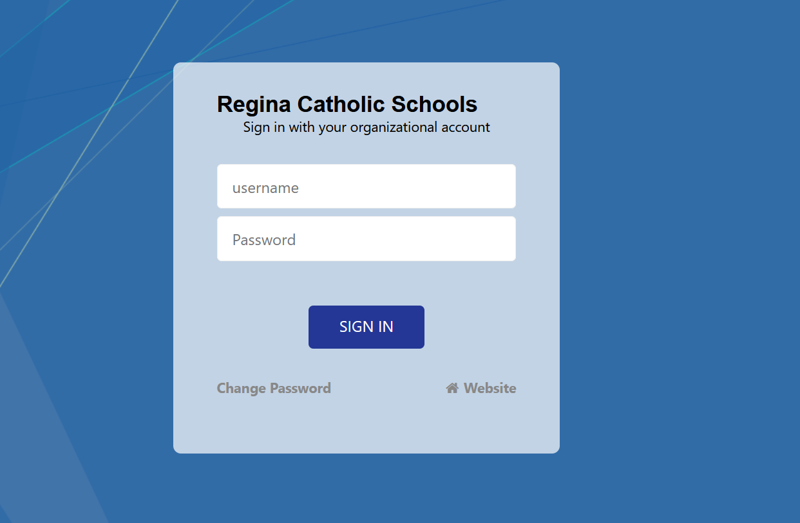

Slide 32
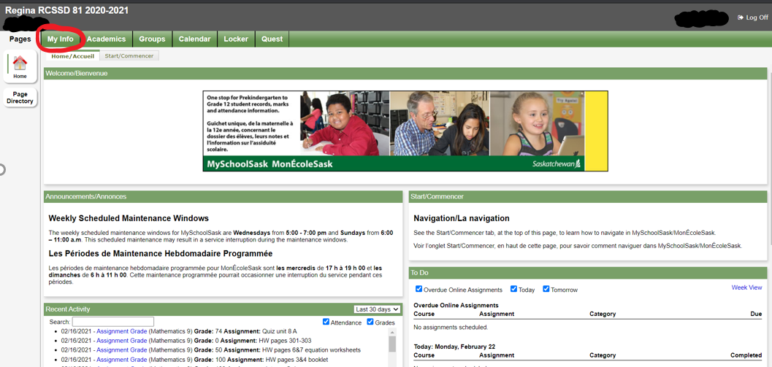

Log into your MSS account and click on My Info

Slide 33
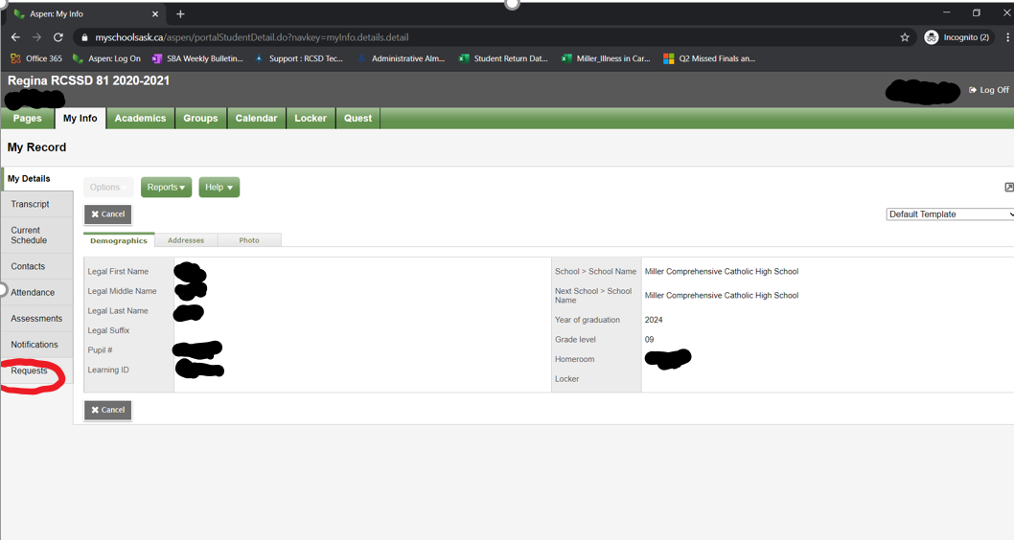
Select Requests

Slide 34
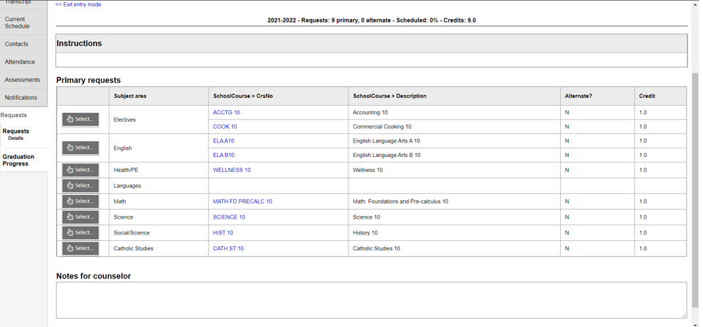
In order to pick your classes:
Select the subject area that your desired class is under [Click the left “Select” box].
Example – the arrow is selecting the math subject area…

Slide 35
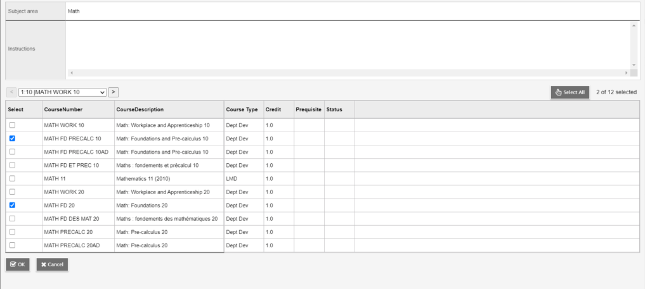
You may need to scroll to a second page for all the classes in a category.
A listing of all classes in the subject category will appear.
Select the class(es) that you need and click OK

Slide 36
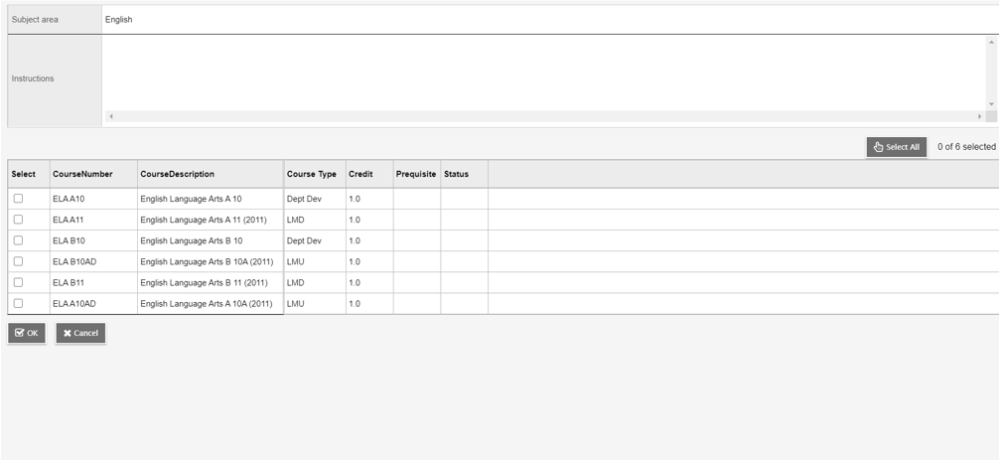
Here is another example using ELA selections
Remember to hit OK after selecting

Slide 37
Once you have selected all of your classes YOU MUST HIT THE POST BUTTON so it saves your requests!!!!!
POST

Slide 38
Do Your Research!
Take some time in the next couple of days to do some planning
Make sure you keep your post graduation requirements and post secondary plans in mind when selecting your courses.
Take a look at the course description booklet. It provides a detailed description for each class we offer. (On the Miller Website)
Talk to your teachers
Please stop by student services if you have questions or email any one of us from the student services team.
Registration closes March 9th, 2026

Slide 39
Remember….
We are projected to have over 1500 students next year! This means that classes will be full.
Choose classes carefully! We create classes based on what is chosen during subject selection.
Reasons for class changes…
pre-requisite issue
to meet grad requirement/post-secondary requirement
Keep in mind that these changes can only be made if there is room in a class. It’s your responsibility to keep track of your credits and know the pre-requisites for the classes you select.
If you aren’t sure/need help, ask!

Slide 40


Slide 41
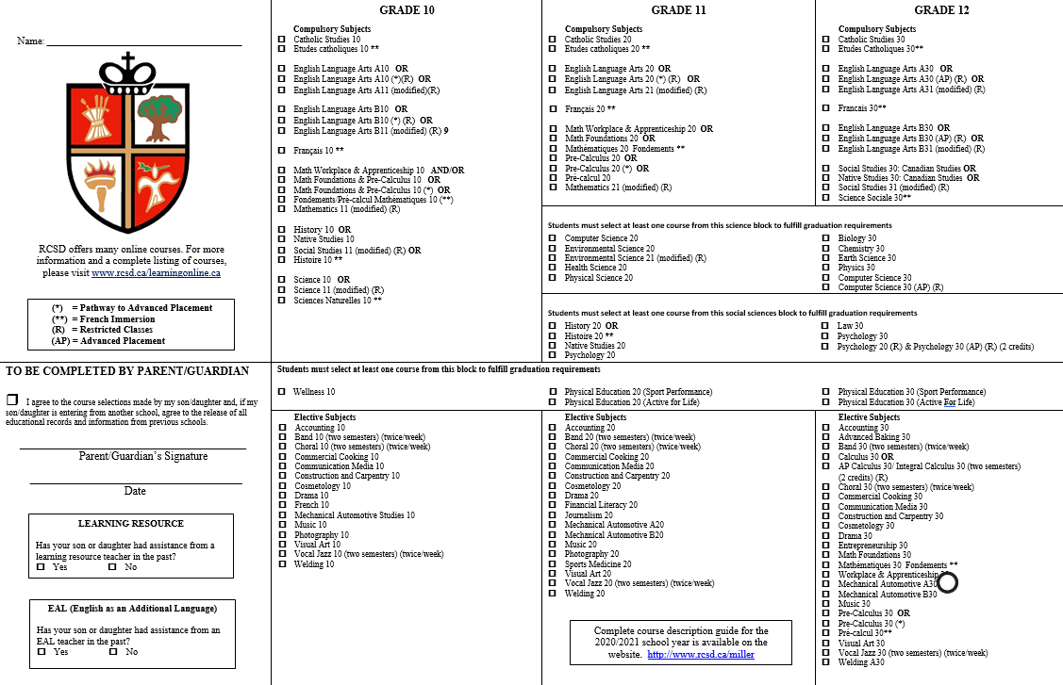

Slide 42



Thank You!
Questions? Please do not hesitate to contact us if you need any assistance.
J.Baragar@rcsd.ca
M.Harbus@rcsd.ca
L.Gaboury@rcsd.ca
N.Burke@rcsd.ca

