Slide 1




Miller Comprehensive High School Course Selection 2024-2025
Welcome Parents and Students
Meet the Student Services Team:
Jodi Baragar
Rhonda Barnes–Pitka
Barb Barnes Wilcox
Navanga Burke (Mentorship)
Respectfully acknowledging that we are blessed to live on Treaty 4 Territory, traditional lands of the Nêhiyawak, Nahkawé, Nakota, and homeland of the Métis, Lakota, and Dakota.

Slide 2


Miller Comprehensive High School Course Selection 2024-2025
What Classes Should I Take?
This Photo by Unknown Author is licensed under CC BY-NC

Slide 3
Students Must Have 24 Credits
A credit is earned when a class is successfully completed. Students must have a minimum of 24 credits to graduate which includes compulsory subjects at each grade level.
Students in French Immersion also need a minimum of 24 credits. To graduate with a French Immersion designation, students must have at least 12 of their credits from the French Immersion Program.

Slide 4
French Immersion Students Must Have 24 Credits
For Bilingual Mention, students must take a minimum 12 credits from French Immersion Subjects in grades 10-12.
The following French Immersion courses are offered at Miller High School:
Three compulsory English Language Arts credits are required for Graduation.
ELA A10 and/or ELAB10
ELA 20
ELAA30 and/or ELAB30
*Some post-secondary programs may require more than 3 ELA credits.
Études es catholiques 10, 20, 30 | Mathématiques 20 Fondements
Français 10, 20, 30 | Mathématiques 20 Pré-calcul
Sciences 10 | Mathématiques 30 Fondements
Sciences sociale (Histoire) 10 | Mathématiques 30 Pré-calcul
Sciences sociale (Histoire) 20 | Mathématiques 10 Fondements/Pré-calcul
Sciences sociales 30 | Litteratie financiere 10

Slide 5
Grade 10 Course Requirements
Math 10 FP or WA / Math 11
Catholic Studies 10
ELA A10 / A11 OR ELA B10 / B11
Science 10 / 11
History 10 / 11 or Native Studies 10
Financial Literacy 10
4 Electives

Slide 6
French Immersion Grade 10 Course Requirements
Mathématiques 10- Fondements/Pré-calc
Études catholiques 10
Français 10
ELA A10 OR ELA B10
Litteratie financiere 10
Science naturelles 10
Histoire 10
3 Electives
* French Immersion students have the option to take 1 or both grade 10 ELA classes.

Slide 7
Grade 11 Course Requirements
Catholic Studies 20
ELA 20 / 21
Math 20 / 21 (Workplace/Foundations/Pre-Calculus)
Science 20 / 21 (Computer/Environmental/Health/Physical)
Social Science 20 or 30 – recommended to take in grade 11.
Electives (5)
**NOTE: For current grade 9’s only, a Social Science class is no longer a requirement, however, can be taken as an elective.

Slide 8
French Immersion Grade 11 Course Requirements
Mathématiques 20 (Fondements/Pré-calc)
Études catholiques 20
Français 20
ELA 20
Histoire 20
Science 20
4 Electives
**NOTE: For current grade 9’s only, a Social Science (Histoire 20) class is no longer a requirement, however, can be taken as an elective.

Slide 9
Grade 12 Course Requirements
Catholic Studies 30
ELA A 30 / 31
ELA B 30 / 31
Social Studies 30 / 31 or Native Studies 30
Electives
5 Credits need to be at the 30 level
NOTE: Current grade 9’s will only have to take ONE ELA 30 course when they enter grade 12.

Slide 10
French Immersion Grade 12 Course Requirements
Études catholiques 30
Français 30
ELA A30
ELA B30
Sciences sociales 30
5 Electives
*French Immersion students have the option to take 1 or both grade 30 ELA classes.
*Some post-secondary programs may require more than 3 ELA credits.

Slide 11


So, Which Math Class Should I Take?
The answer depends:
Post-secondary plans
Math strengths
Recommendation of your math teacher

Slide 12
Math Department Recommendations
If you are unsure about your career path, you should consider taking both Workplace & Apprenticeship 10 and Foundations & Pre-Calculus 10.
If your mark in Math 9 is under 60%, you should consider taking Workplace & Apprenticeship 10.
If you plan to take Calculus later, you should take Foundations & Pre-Calculus 10 in the first semester and Foundations 20 in the second semester.
It is not recommended to take Pre-Calculus 20 in grade 10 and it is recommended to complete Foundations 20 before taking Pre-Calculus 20.

Slide 13
Math Pathways
Workplace and Apprenticeship
Content in this pathway was chosen to meet the needs of students intending to pursue careers based on post-secondary education at Sask Polytech, or non-math oriented faculties at universities
30% to 40% of all Grade 12 graduates are entering fields for which the mathematics in this pathway is appropriate.
2. Foundations
Content in this pathway was chosen to meet the needs of students intending to pursue careers in areas that typically require university, but are not math intensive, such as the humanities, fine arts, social sciences, business and nursing.
40% to 60% of all Grade 12 graduates are entering fields for which the mathematics in this pathway is appropriate.
3. Pre- Calculus
Content in this pathway was chosen to meet the needs of students interested in pursuing careers in science-related or math related areas.
10% to 20% of all Grade 12 graduates are entering fields for which the mathematics in this pathway is appropriate.

Slide 14
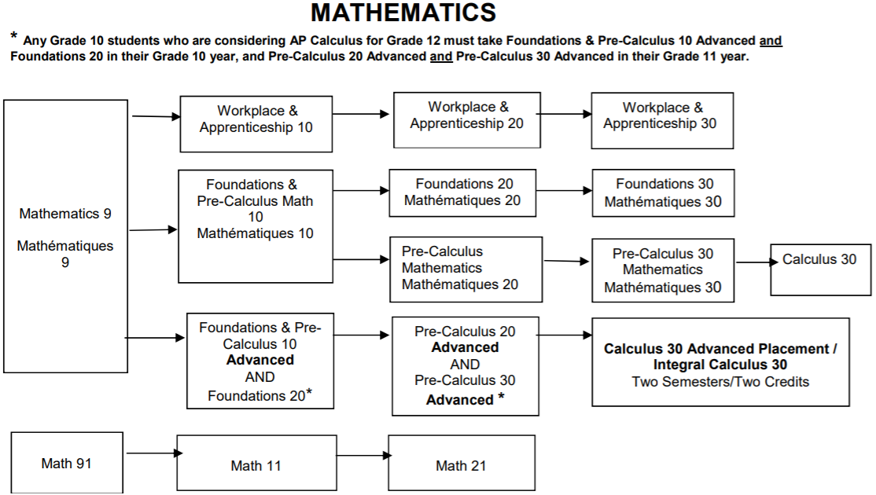

Slide 15
Career Options and Trades with Workplace & Apprenticeship Math
Justice Studies diploma
Correctional Studies
Photography
Continuing Care
Early Childhood Education
Graphic Communications
Funeral Services
Heavy Equipment Operator
Plumbing and Pipefitting
Machining
Welding
Carpentry
Bricklayer
Esthetician
Hairstylist
Hotel and Restaurant Management

Slide 16
University of Regina Faculties that accept Workplace and Apprenticeship Math:
Education (most areas)
Media, Arts & Performance (formerly Fine Arts)
Faculty of Arts
Social Work

Slide 17
University of Regina Faculties that accept Foundations Math:
Arts
Business Administration
Education (most programs)
Media, Arts & Performance (formerly Fine Arts)
Nursing
Social Work

Slide 18
University of Regina and Saskatchewan Polytechnic programs that require the Pre-Calculus Math Pathway:
Engineering and Engineering Technologies
Teaching math/science at the high school level
Science
Pre-professional programs (e.g., pharmacy, medicine, veterinarian medicine, dentistry, optometry, physical therapy)
Kinesiology

Slide 19
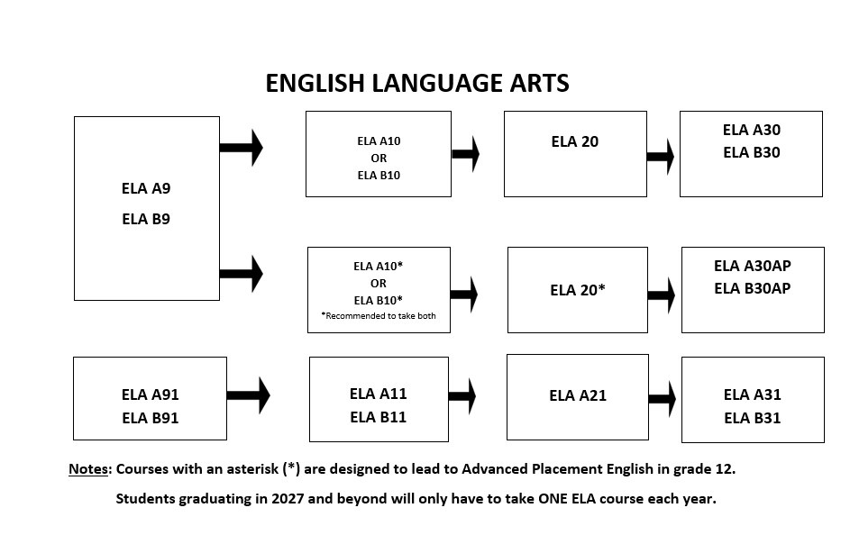

Slide 20
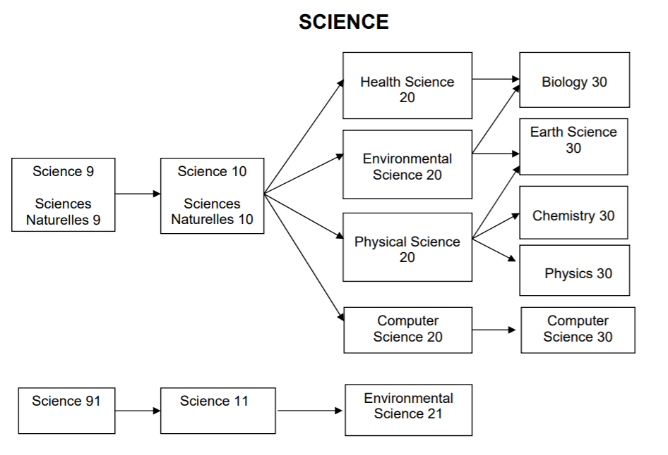

Slide 21
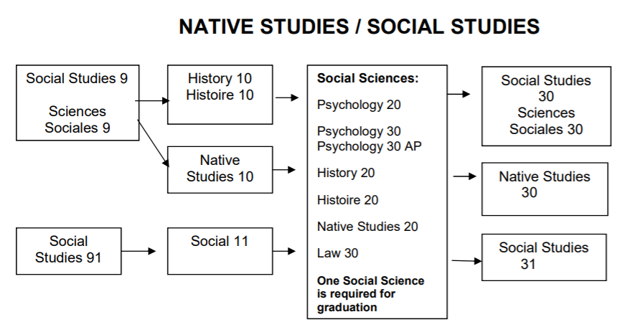

Slide 22
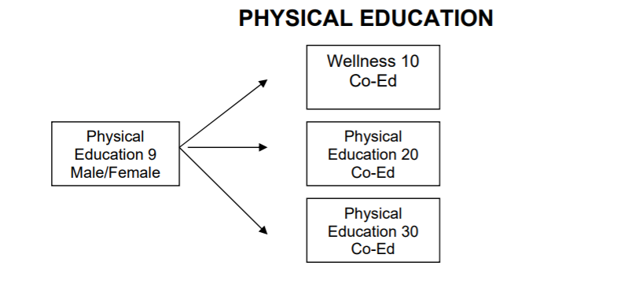

Slide 23

Benefits of Taking AP
Students can challenge themselves academically
Provide challenges for higher level thinking and more in-depth application of knowledge and skills
Scoring a 4 or 5 on an AP exam will help students gain a university credit (save time and money)

Slide 24
AP Mathematics Track
 | Semester One | Semester Two
Grade 10 | Math Foundations 10 Advanced | Math Foundations 20
Grade 11 | Pre-Calculus 20 Advanced | Pre-Calculus 30 Advanced
Grade 12 | AP Calculus/ Integral Calculus | AP Calculus (Exam in May)

Slide 25
Other AP course offerings
 | Semester One | Semester Two
Grade 11 Or Grade 12 | Psychology 20 Computer Science 30 Francais 30 | Psych 30 AP AP CS Prep Course French Language and Culture Prep Course (Exams in May)

Slide 26
AP English Track
 | Semester One | Semester Two
Grade 10 | Advanced ELA A 10 | Advanced ELA B10 (both recommended but not required)
Grade 11 | Creative Writing 20 or Media Studies 20 (Recommended) | Advanced ELA 20
Grade 12 | AP ELA B30 | AP ELA A30 (Exam in May)

Slide 27

Learning Online
www.rcsd.ca/learningonline
Student Services will assist you with registering for an online class.
School administration has to give final permission for full enrollment in the class

Slide 28

What Makes a Successful Online Student?
Do you have good written communication skills?
Are you self-motivated and self-disciplined?
Are you willing to contribute & actively participate?
Do you have a good knowledge of computer skills?
Are you committed?

Slide 29
Electives
Advanced Baking
Accounting
Band and/or Choral/Vocal Jazz (EB)
Mechanics & Automotive
Commercial Cooking
Communication Media
Construction & Carpentry
Hairstyling and Esthetics
Drama
Media Studies
Financial Literacy
Mechanics & Automotive
Music
Physical Education/Wellness
Psychology
Sports Medicine
Visual Arts
Entrepreneurship
Photography
Welding

Slide 30
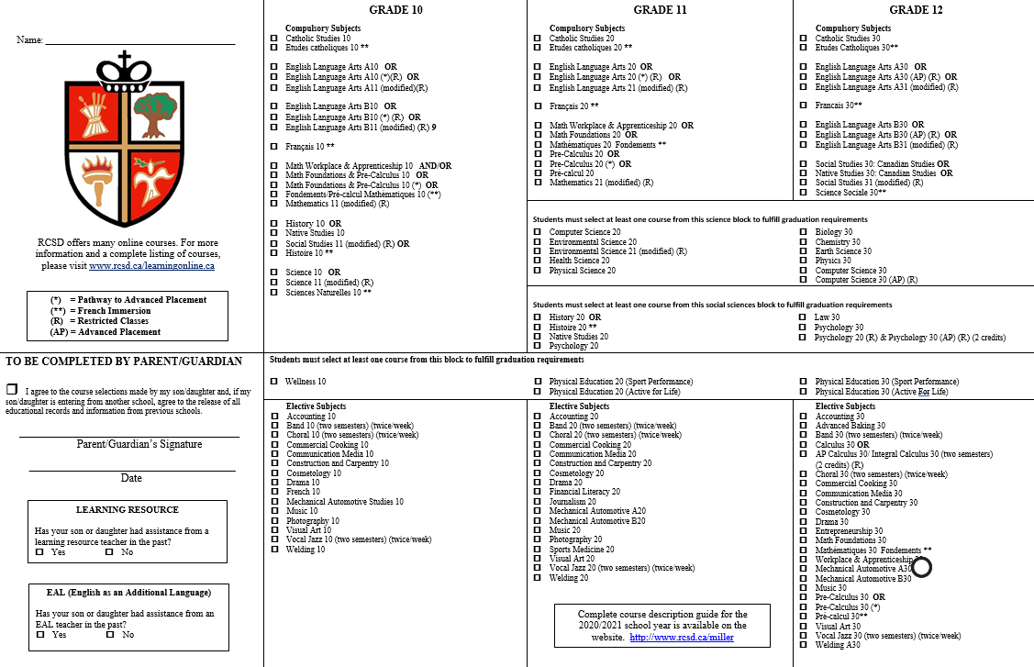

Slide 31
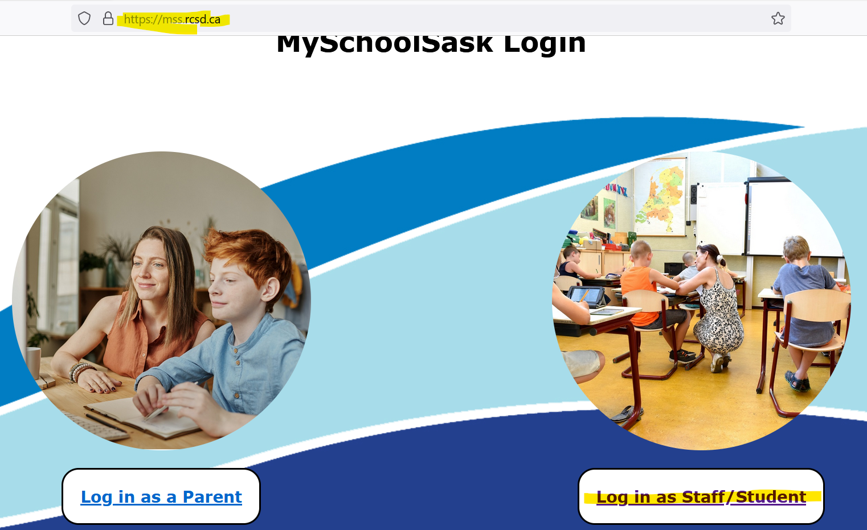

Slide 32
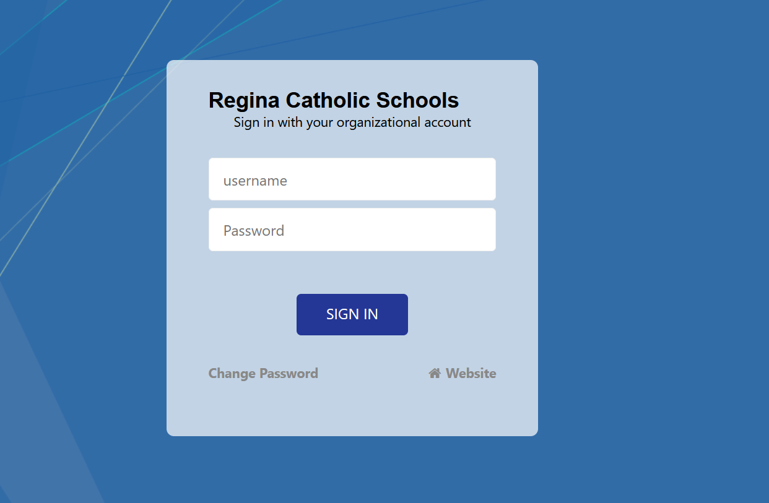

Slide 33
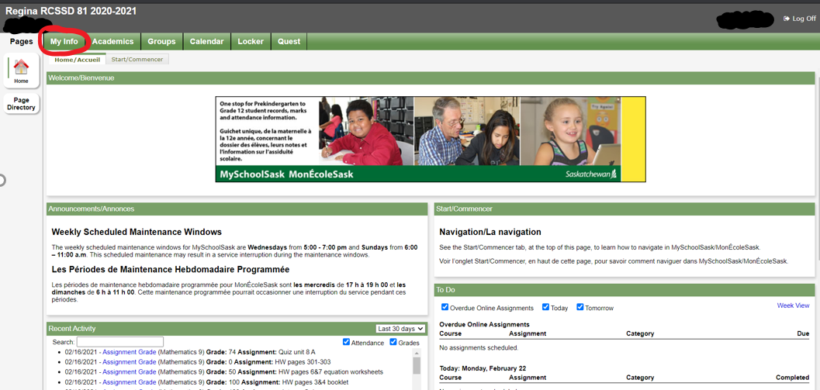

Log into your MSS account and click on My Info

Slide 34
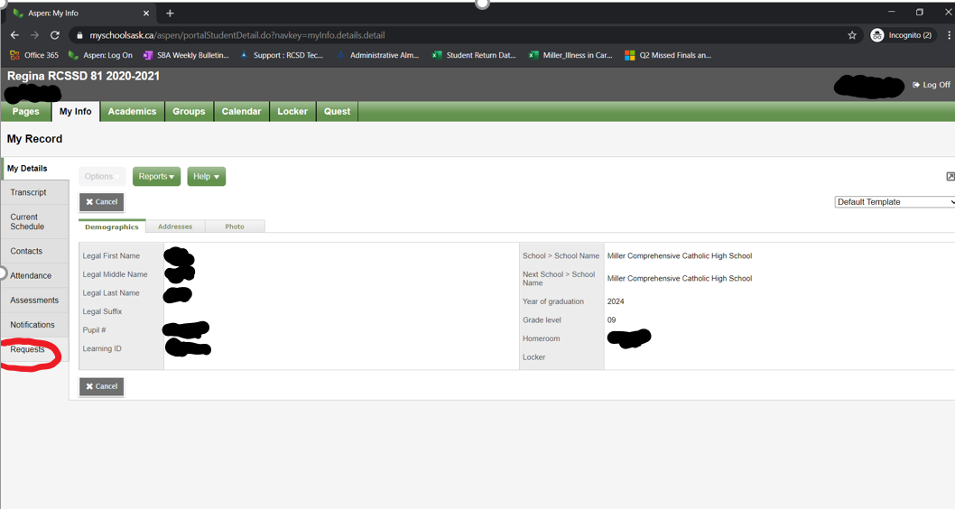
Select Requests

Slide 35
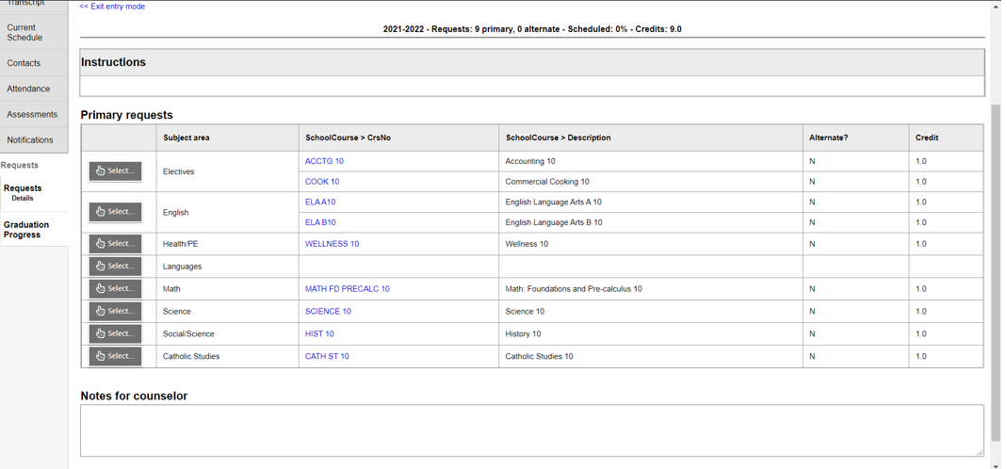
In order to pick your classes:
Select the subject area that your desired class is under [Click the left “Select” box].
Example – the arrow is selecting the math subject area…

Slide 36
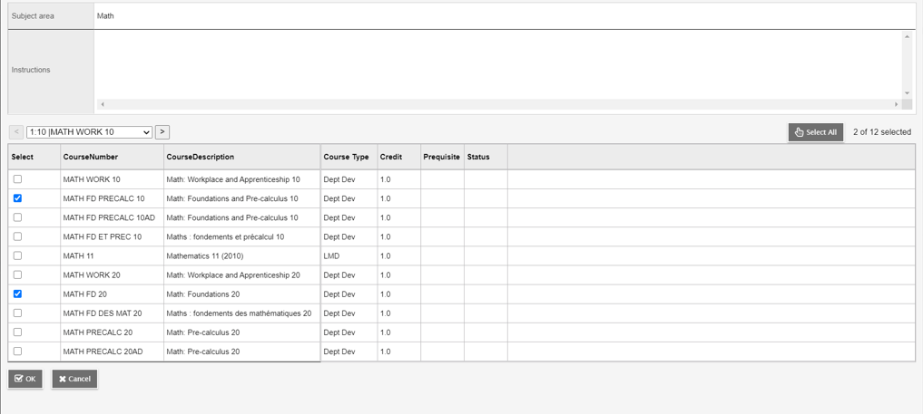
You may need to scroll to a second page for all the classes in a category.
A listing of all classes in the subject category will appear.
Select the class(es) that you need and click OK

Slide 37
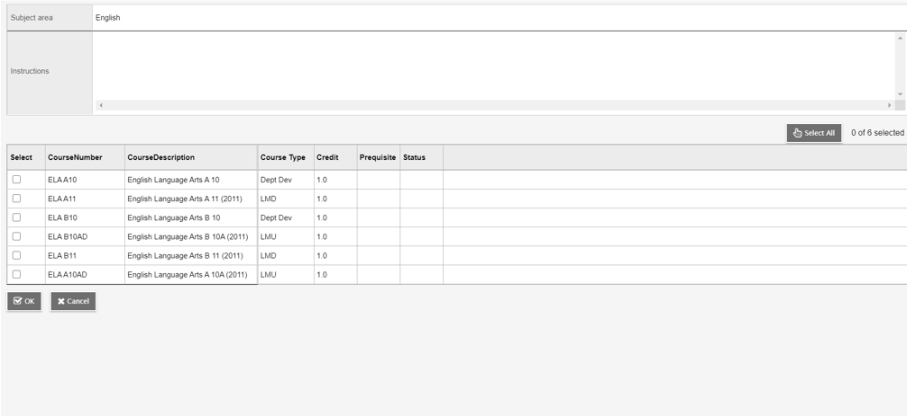
Here is another example using ELA selections
Remember to hit OK after selecting

Slide 38
Once you have selected all of your classes YOU MUST HIT THE POST BUTTON so it saves your requests!!!!!
POST

Slide 39
Do Your Research!
Take some time in the next couple of days to do some planning
Make sure you keep your post graduation requirements and post secondary plans in mind when selecting your courses.
Take a look at the course description booklet. It provides a detailed description for each class we offer. (On the Miller Website)
Talk to your teachers
Please stop by student services if you have questions or email any one of us from the student services team.
Registration closes March 8th, 2024
Grade 9-11 Parent Night: Wednesday, February 28th 6:30pm Theatre

Slide 40
Remember….
We are projected to have over 1300 students next year! This means that classes will be full. Choose classes carefully! We create classes based on what is chosen during subject selection.
Reasons for class changes…
pre-requisite issue
to meet grad requirement/post-secondary requirement
Keep in mind that these changes can only be made if there is room in a class. It’s your responsibility to keep track of your credits and know the pre-requisites for the classes you select. If you aren’t sure/need help, ask!

Slide 41


Slide 42



Slide 43

NEW FOR 2024-2025 SCHOOL YEAR
Regina Catholic Schools will be partnering with Golden Ticket Sports to create an exciting opportunity for grade 9 and 10 students for the 2024-2025 school year who wish to specialize and hone their sport specific skills.
Golden Ticket Sports is already working with Regina Catholic schools to provide basketball and hockey opportunities for our elementary students.
Students would still attend their respective Catholic high school during the morning while enrolled in the academy.
Students would still represent their respective high school teams for RHSAA & SHSAA Athletics.
This program does not feature a “team competition model” - i.e there are no formal games against other teams.
Students would receive their Phys Ed offering and one other academic course on site via qualified Regina Catholic teachers.
High quality coaches from across the city will lead the skills instruction while our teachers will ensure the delivery of course outcomes.
The fee for the academy covers all program costs as well as one-way transportation from home schools at lunch for the afternoon courses.
Currently, parents would be responsible for providing transportation from the program home at the end of the day.
The proposed sports offered for the 2024-2025 school year are Hockey, Soccer, and Basketball.

Slide 44
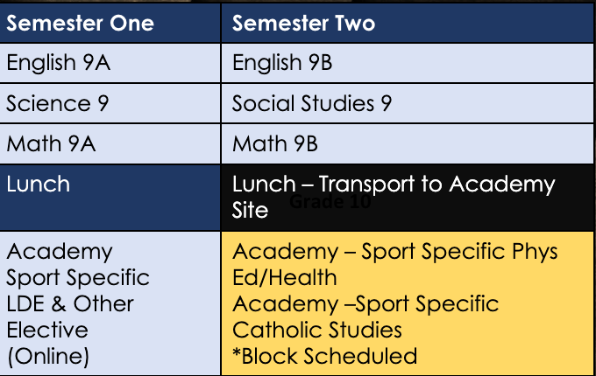
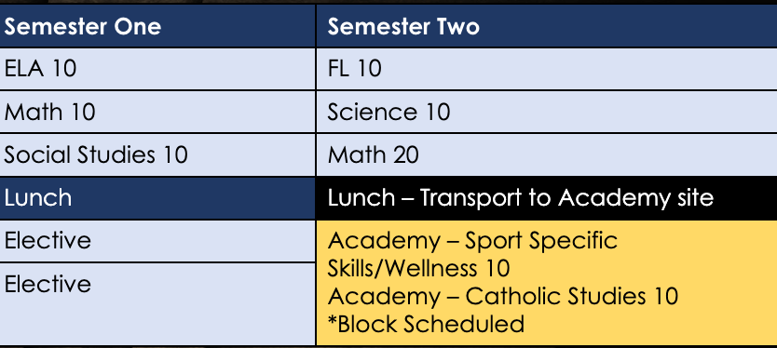
HIGH SCHOOL ACADEMIES SEMESTER SCHEDULE OVERVIEW
Grade 9
Grade 10
This new program would be an extension into high school by offering sport specific programming, built into the student’s day to day.
Students would take 8/10 regular courses at their home schools while two of their courses would be covered in the afternoon as part of semester two class schedules for grade 9 students, and either semester one OR two class schedules for grade 10 students.
Anticipate 2x per week on court/ice/turf minimum.
Dedicated classroom space @ REAL for 2024-2025 School Year.
Transportation would be provided via school buses. ​
A north bus(es) and a south bus(es) would do these runs. ​
Transportation following the afternoon completion would be the responsibility of the family.
SEMESTER SCHEDULE SUBJECT TO CHANGE BASED ON SPORT OFFERINGS, INTEREST, AND AVAILABLE SECTIONS WITHIN PROGRAM

Slide 45
Program Timelines and FAQ’s
Can my child still participate on their High School Sport Team:
We are working with SHSAA and within the existing bylaws so that students are eligible for the high school teams.
How much will the academy cost:
Final per sport program fees will be finalized in the coming months as we await budgetary information from our partners and hosts.
Who will lead the instruction of the sport specific programming?
Staffing is currently on-going for both RCSD and outside sport specialist coaches. Our intent is to have the highest possible quality staff for all areas of the program.
When is the deadline to register?
April 5th, 2024 - Registration will open February 26th, 2024.

Slide 46
Contact Information
Sport Academy Director
Tanner Brightman
tanner@goldenticketsports.com
RCSD Superintendents
Kelley Ehman
k.ehman@rcsd.ca
Dave Magnusson
d.magnusson@rcsd.ca
Registration will open February 26th, 2024 via Golden Ticket Sports
Registration Deadline is April 5th, 2024

Slide 47




Thank You!
Questions? Please do not hesitate to contact us if you need any assistance.
J.Baragar@rcsd.ca
B.Barnes-Wilcox@rcsd.ca
R.Barnes-Pitka@rcsd.ca
N.Burke@rcsd.ca

